Slide 1

Emergent Abilities| Few Shot Learners
MAI5301

Slide 2

RECAP

Slide 3
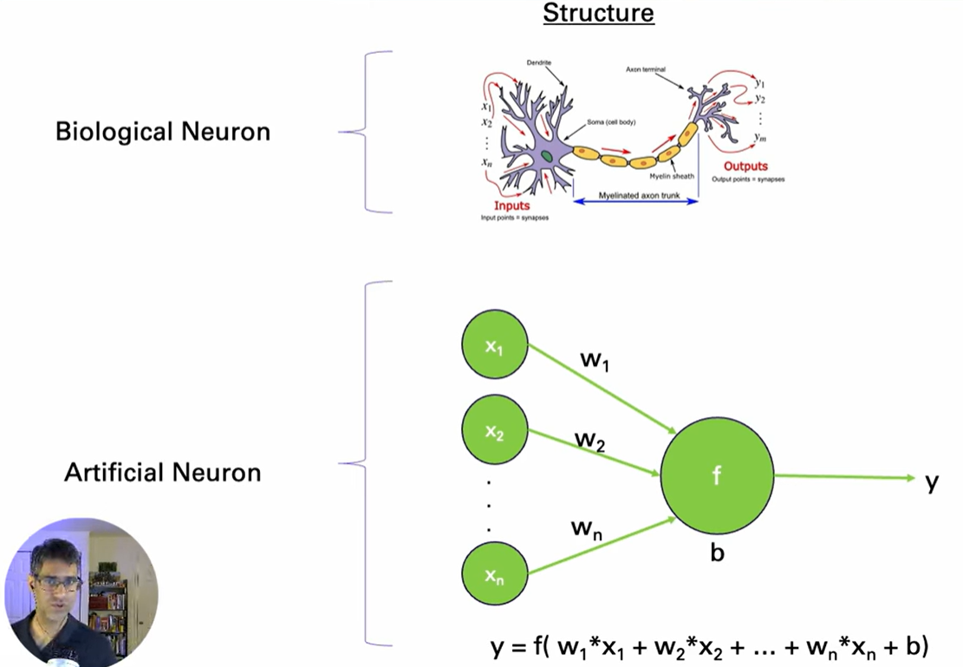
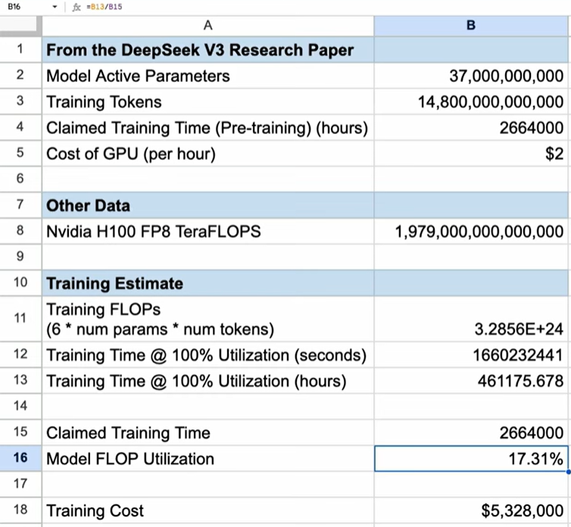
FLOPs
https://www.youtube.com/watch?v=T3JiBtHHTMU
Notes:
Taking a bunch of inputs, it multiplies them times some weights and then it puts it through some activation function. So, the key operation that happens the most inside the model is this neural calculation. And it is simply for every single weight here there's a multiply right here and then an addition. So basically, for every single weight there's two operations you're going to do a multiply and then an addition. And it turns out this dominates most of the calculation or flops that happen inside the model

Slide 4
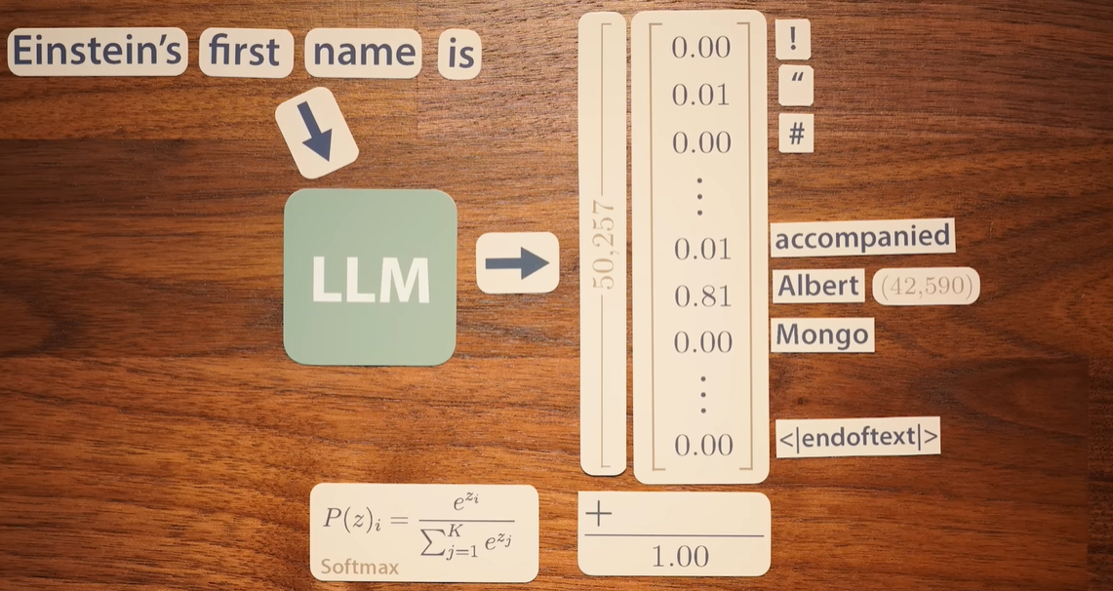
Autoregressive models GPT3
Trained to predict the next word or word fragment in sequences of text as a function of the words that came before
Notes:
The difference between 1 and the highest probability is known as the loss. Then passing the loss through another function gives us what is known as the cross-entropy loss. The foundation of cross entropy loss is the maximum likelihood estimators.

Slide 5
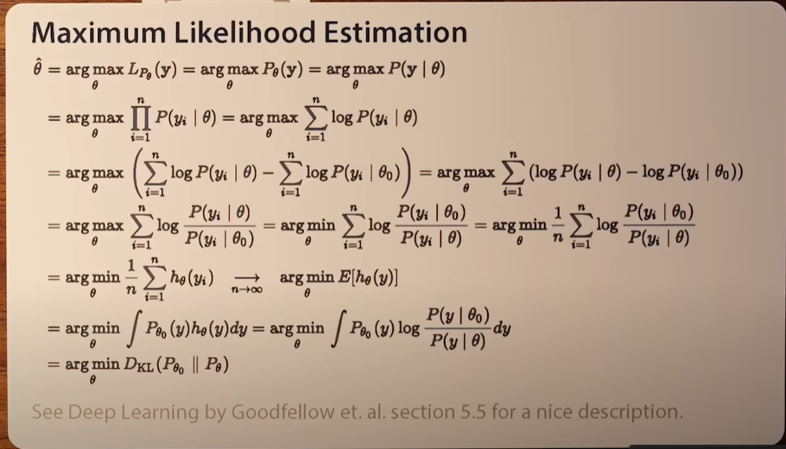
Maximum Likelihood Estimators
It’s a bit complicated but the application is more straightforward

Slide 6
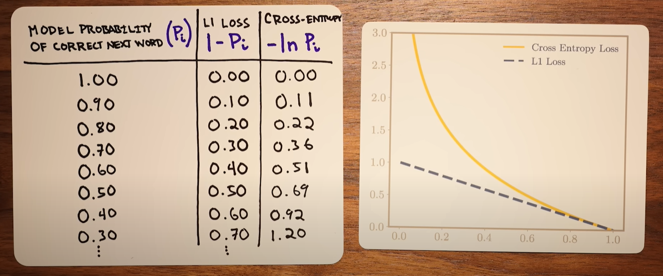
Cross entropy loss example

Slide 7
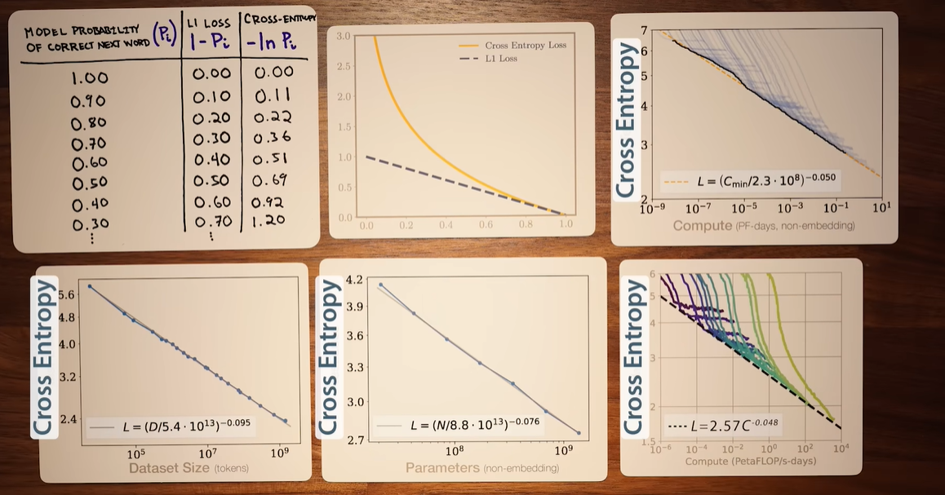
Cross entropy loss applications
Notes:
The cross-entropy loss curves flatten after a while because the likelihood of predicting the next word or word fragment can hardly ever be at 100% certainty. For example..

Slide 8
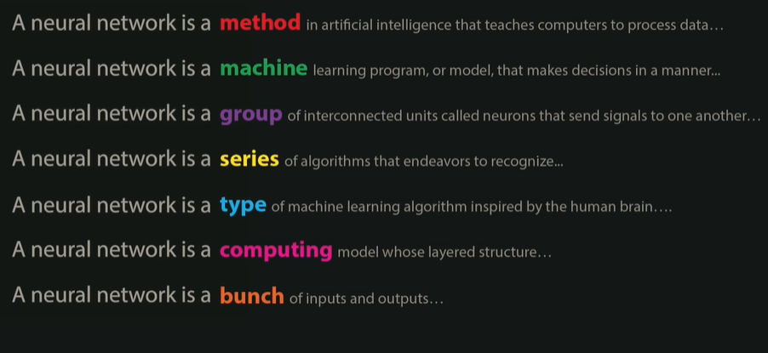
Entropy of natural language
Notes:
…if we consider the sequence of text

Slide 9
END OF RECAP

Slide 10

Emergent Abilities of Large Language Models

Slide 11
Emergent ability
Emergent ability: an ability that is absent in smaller models but appears sharply in larger ones, defying extrapolation from scaling trends.
Random performance in smaller model => Performance increases beyond a threshold.
Notes:
An emergent ability is a capability that is effectively absent in smaller language models yet appears suddenly when models are scaled. The paper defines emergence as a qualitative shift—performance sits near random up to a certain threshold of model scale and then jumps sharply. Because this behavior cannot be predicted by simply extrapolating small-model trends, it challenges simple scaling laws and suggests that new competencies may appear only after enough compute, parameters, and data are brought together

Slide 12
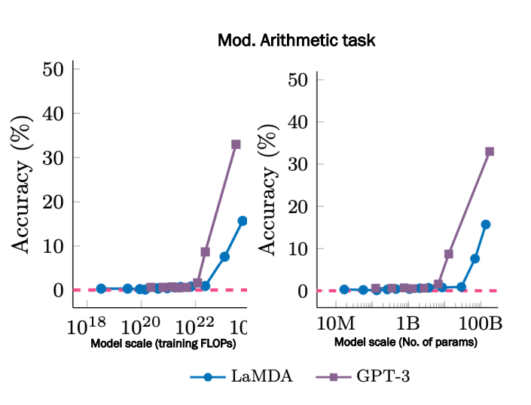
Emergence
Typical features
Cannot be extrapolated using a scaling law.
Concept of a threshold.
Function of multiple correlated features.
Is the scale factor absolute?
Train data quality, model architecture, etc. can reduce number of params, or compute.
Open question: Are our LLMs trained optimally?
Notes:
Emergence is defined as a qualitative behavioral change triggered by incremental scaling, exemplified by random performance in smaller models versus purposeful output in larger ones. Drawing on Philip Anderson’s philosophy—“quantitative changes yielding qualitative outcomes”—the slide clarifies that emergence isn’t a smooth linear progression but rather a threshold-based phenomenon.

Slide 13
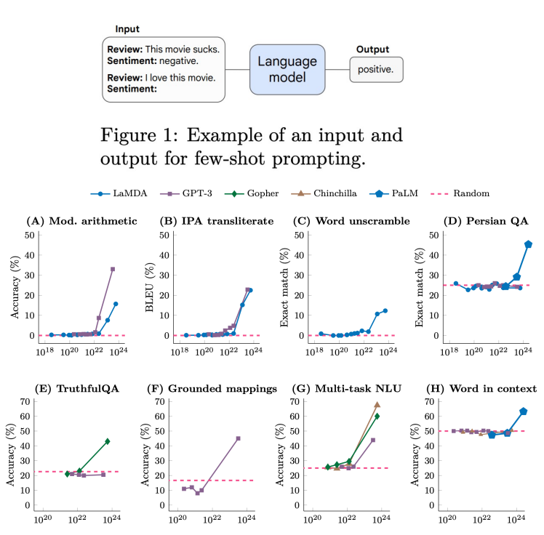
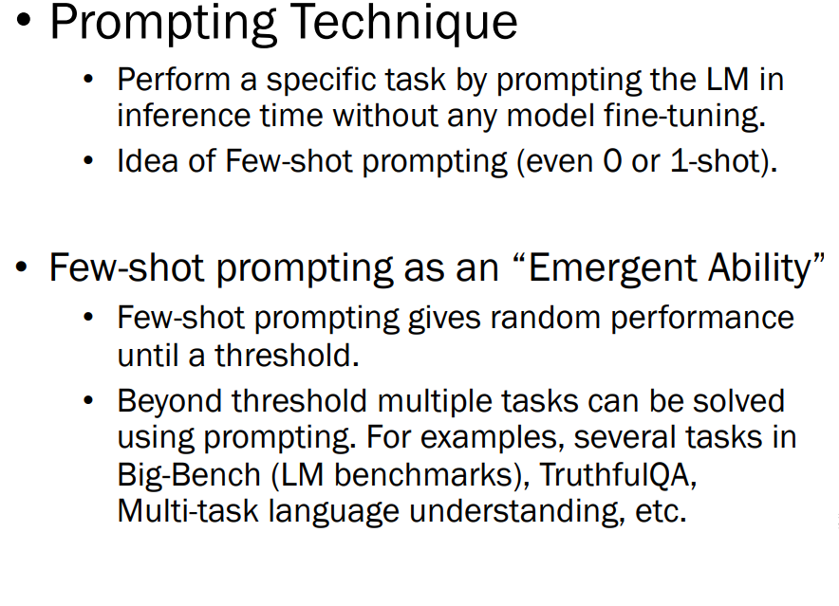
Few-Shot Prompted Tasks
Notes:
Few-shot prompting itself becomes an emergent skill: smaller LLMs struggle initially, whereas larger models pass critical thresholds and handle a variety of tasks like Big-Bench, TruthfulQA, and multi-task language understanding. -prompting only becomes effective past certain scales

Slide 14
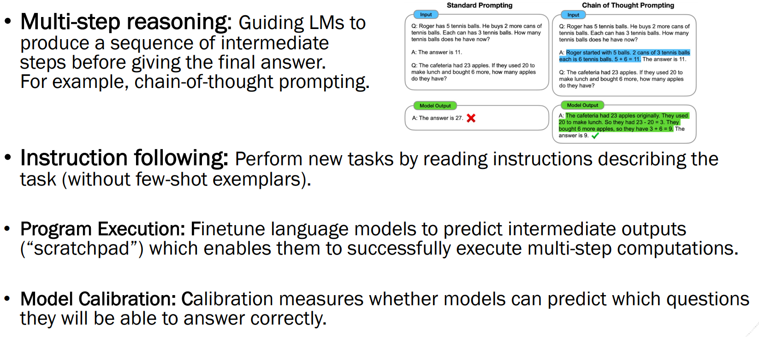
Augmented Prompting Strategies
Notes:
three enhanced prompting strategies—chain-of-thought, instruction-following, and program execution via scratchpads—which rely on intermediate reasoning steps or structured outputs. - these techniques, while ineffective on small models, significantly boost performance and abilities in larger-scale LLMs

Slide 15
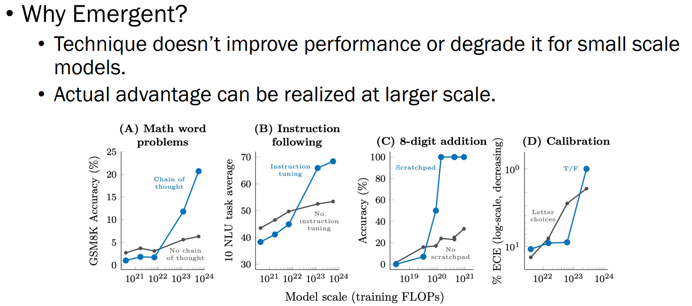
Augmented Prompting Strategies as Emergent Abilities
Notes:
The techniques shown only yield significant benefits at scale. Chain-of-thought prompting or instruction-following offers little to no advantage on smaller models; however, once past a scale threshold, they enable robust reasoning, coherent task execution, and enhanced instruction compliance. -scale dependence

Slide 16
Explanation of “Emergence”
Intuition
Some tasks inherently require deeper networks, eg. Multi-step reasoning.
Task requiring world knowledge benefit from more parameters and training data. (“Memorization?”). For example, closed-book question-answering task may require a model with enough parameters to capture the compressed knowledge base.
Evaluation Metrics
Choices such as Exact string match doesn’t identify incremental advances.
Metric should give partial credits to understand progress.
Notes:
Deeper neural depth enables multi-step reasoning, while more parameters and data enable world knowledge storage—essential for closed-book QA. Some tasks inherently require scale to unlock capabilities, reinforcing the view of emergence as architecture- and capacity-dependent rather than algorithm-limited

Slide 17
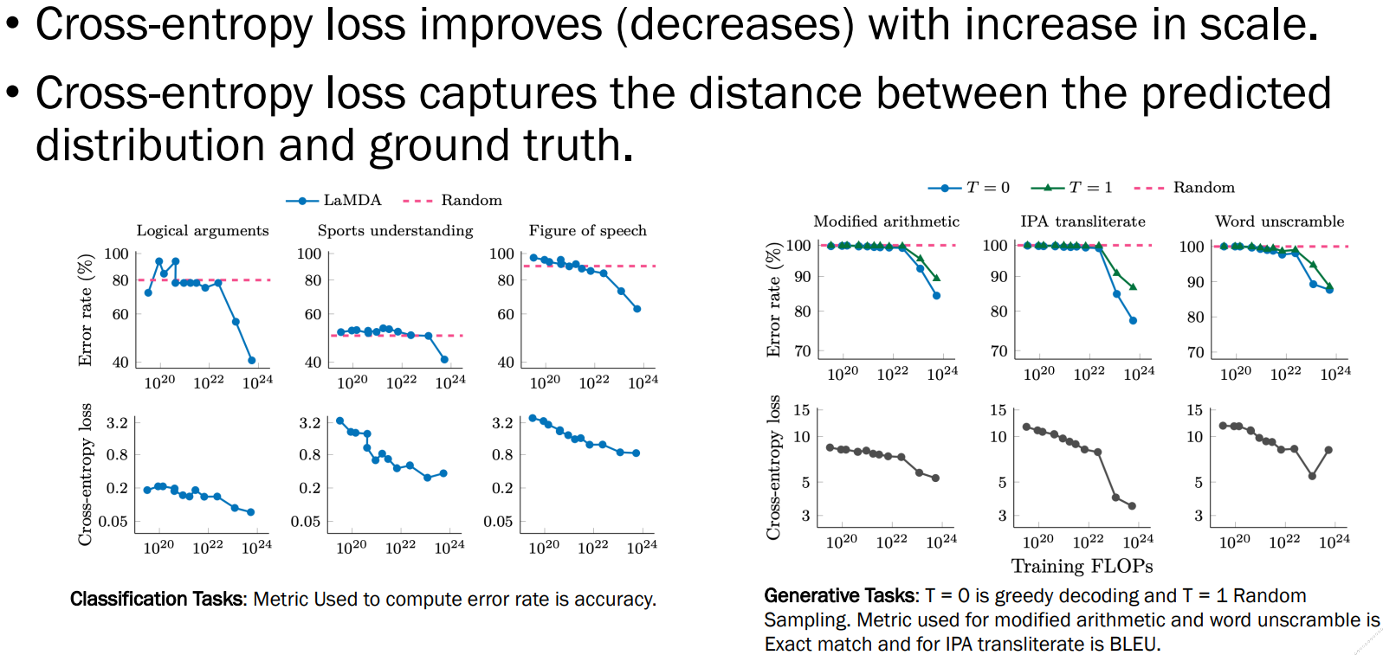
Cross-Entropy Loss
Notes:
Comparison of cross-entropy loss (improves smoothly with scale) with task-specific metrics (e.g., BLEU for generatives) underscores differences in emergent detection. While loss declines steadily, actual performance on challenging tasks jumps at certain scales, illustrating unpredictability of emergent milestones

Slide 18
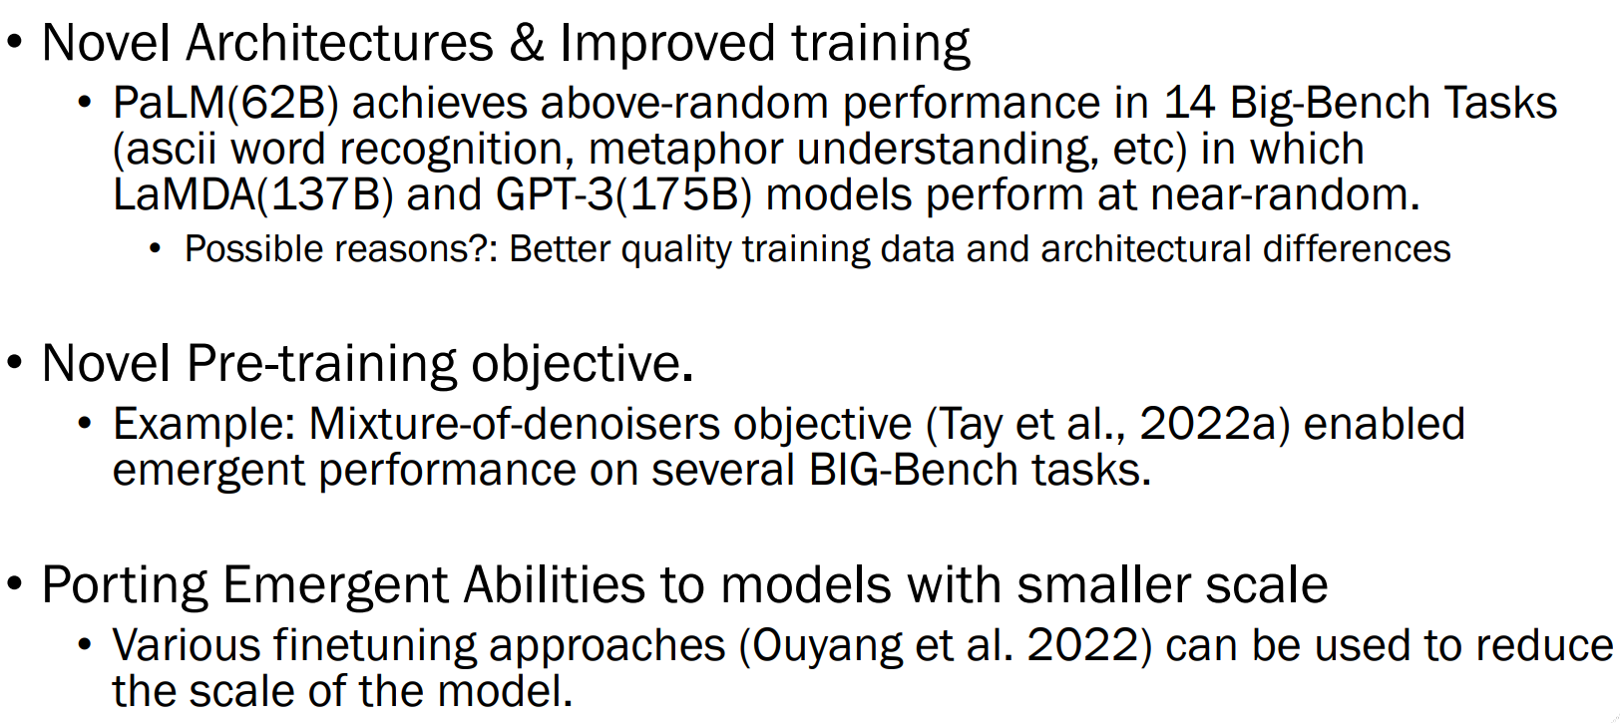
Emergence beyond scaling
Notes:
Emergence isn’t limited to size: architecture and training objectives matter. PaLM (62B) demonstrates emergent behaviors absent in GPT-3 (175B) across select tasks. Likewise, mix-denoisers pre-training architectures enabled novel emergent capabilities. -architecture quality affects emergence thresholds Some emergent abilities can be transferred to compact models via instruction-finetuning with human feedback (e.g., RLHF). -while scale helps, smart fine-tuning methods can simulate emergent features in smaller systems—a promising direction for resource-efficient AI

Slide 19
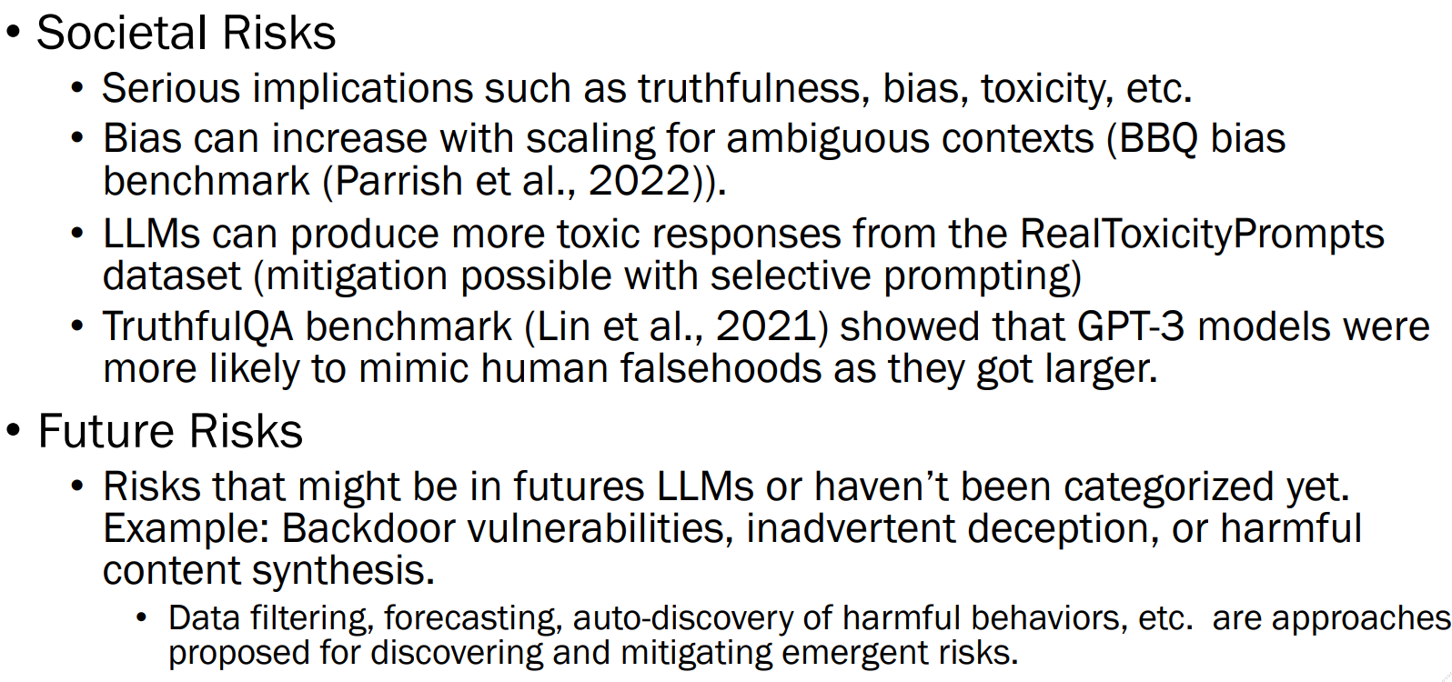
Emergent Risks
Notes:
Scaling amplifies societal risks: biases, toxicity, and hallucinations become more pronounced. Benchmarks like BBQ and TruthfulQA reveal that larger models may replicate human falsehoods or unintended biases. -THERE IS associated dangers when emergent capabilities outpace robustness Threats such as backdoors, deception, or harmful content may emerge only in future LLMs. -proactive strategies including data filtering, forecasting of emergent risks, and automated detection systems to safeguard against unexpected model behaviors.

Slide 20
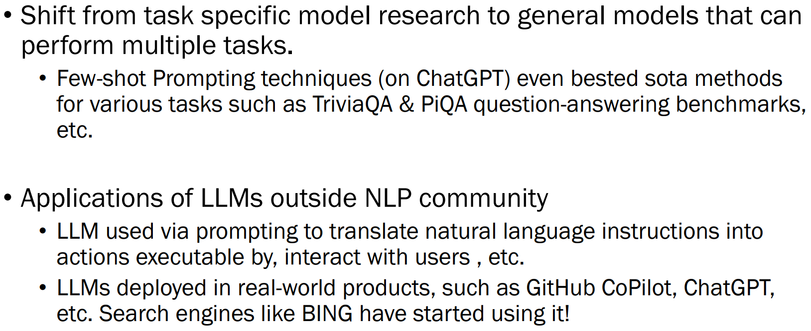
Sociological Impact
Notes:
Emergence is shifting research from task-specific to general models. Few-shot prompting now outperforms state-of-the-art in benchmarks like TriviaQA. LLM applications now span code generation (Copilot), chat (ChatGPT), and search enhancement (Bing), reflecting a paradigm shift in AI utility

Slide 21
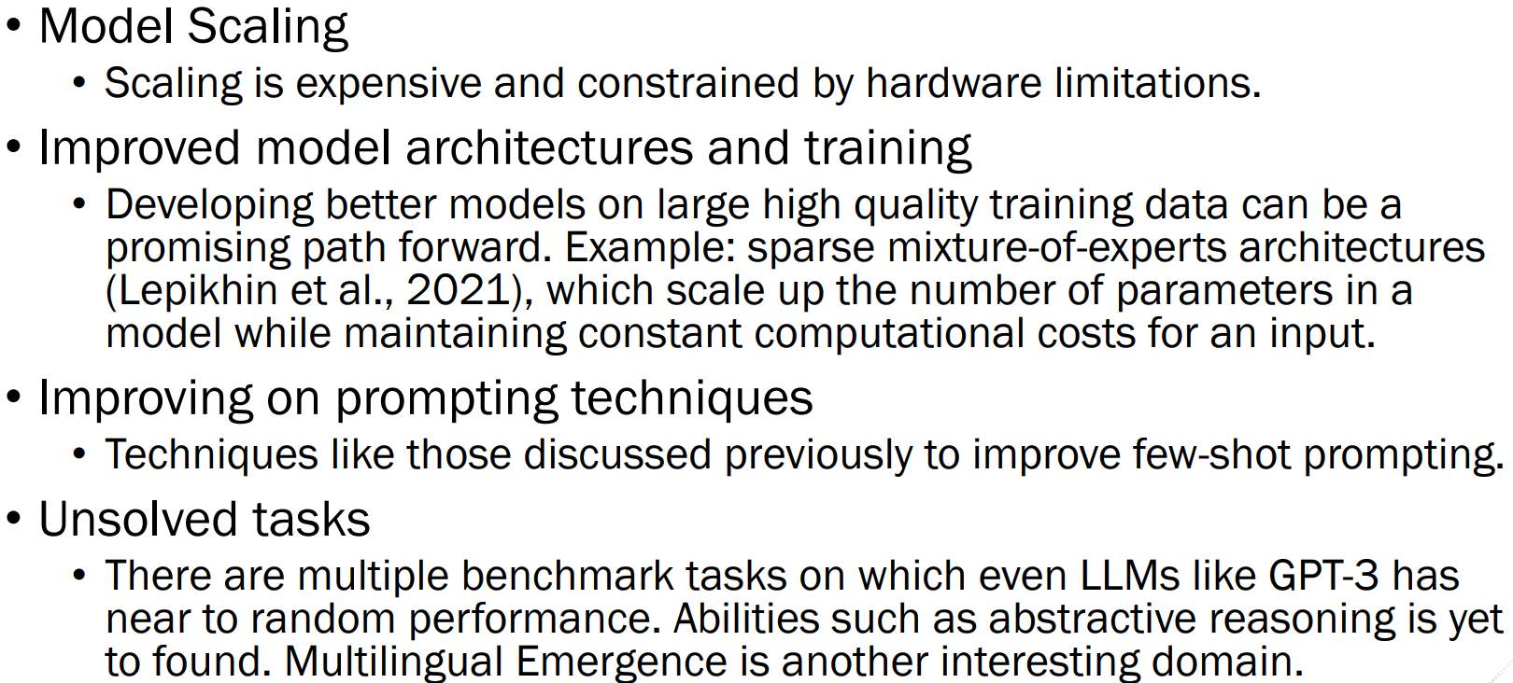
Future Research
Notes:
There are several research frontiers: cost-effective scaling under hardware limits, improved architectures (e.g., mixture-of-experts), enhanced prompting methods, and exploring multilingual or abstractive reasoning abilities that still lag.

Slide 22
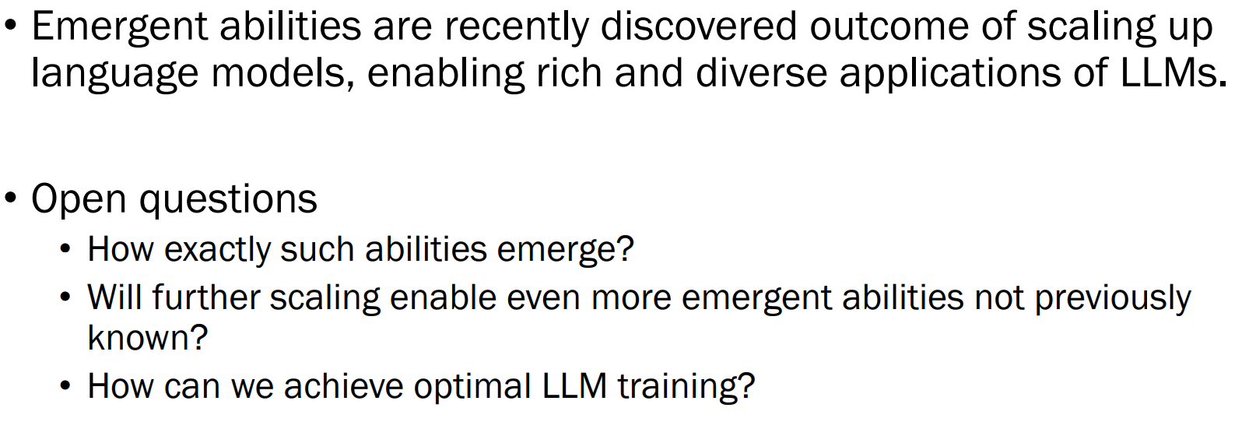
Conclusion

Slide 23
END OF Emergent Abilities of Large Language Models

Slide 24

Language Models are Few-Shot Learners

Slide 25
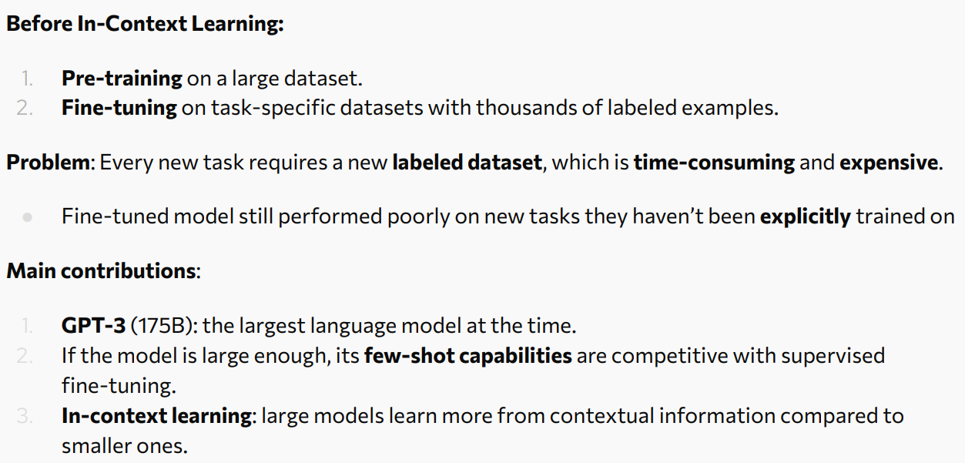
Background Information

Slide 26
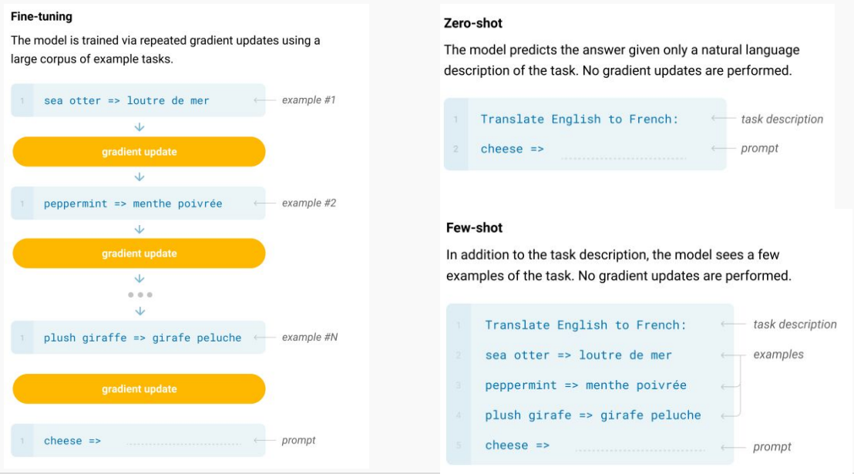
Supervised Fine-tuning vs. In-Context Learning

Slide 27
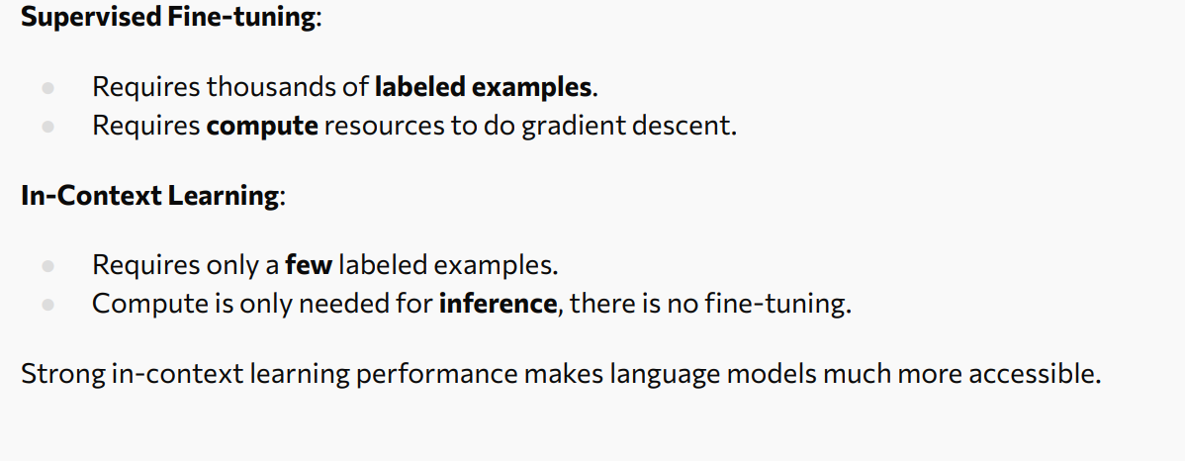
Benefits of In-Context Learning

Slide 28
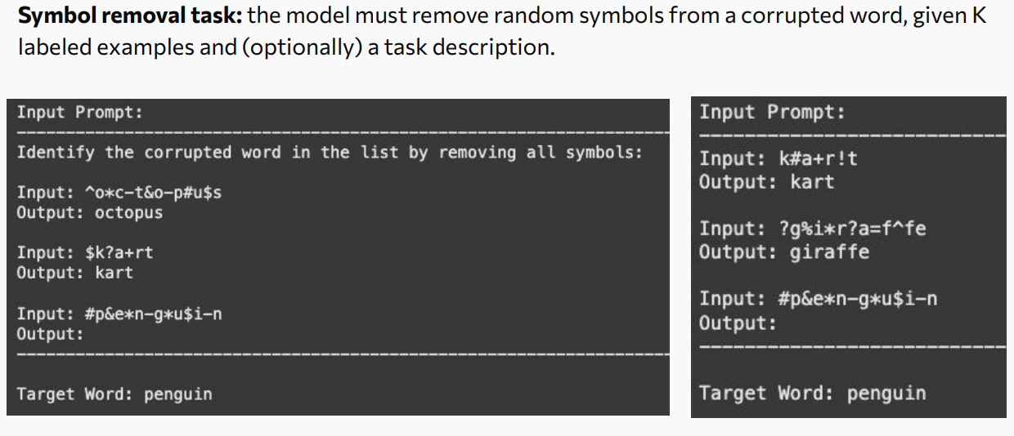
Large Models Learn More From Context

Slide 29
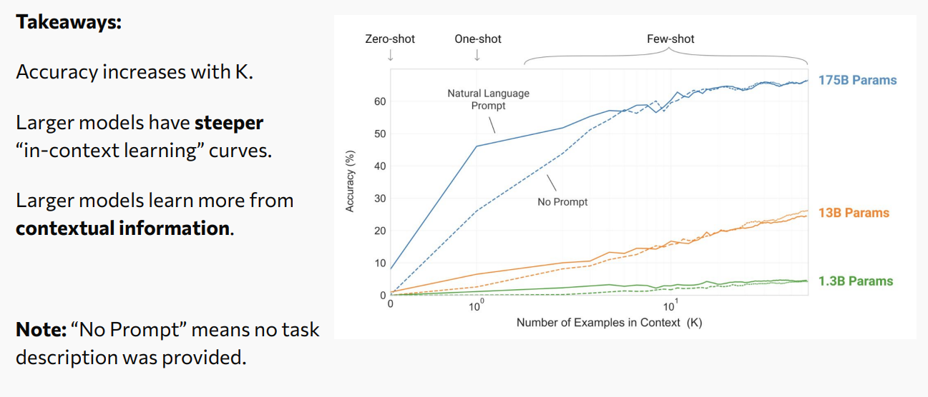
Large Models Learn More From Context

Slide 30
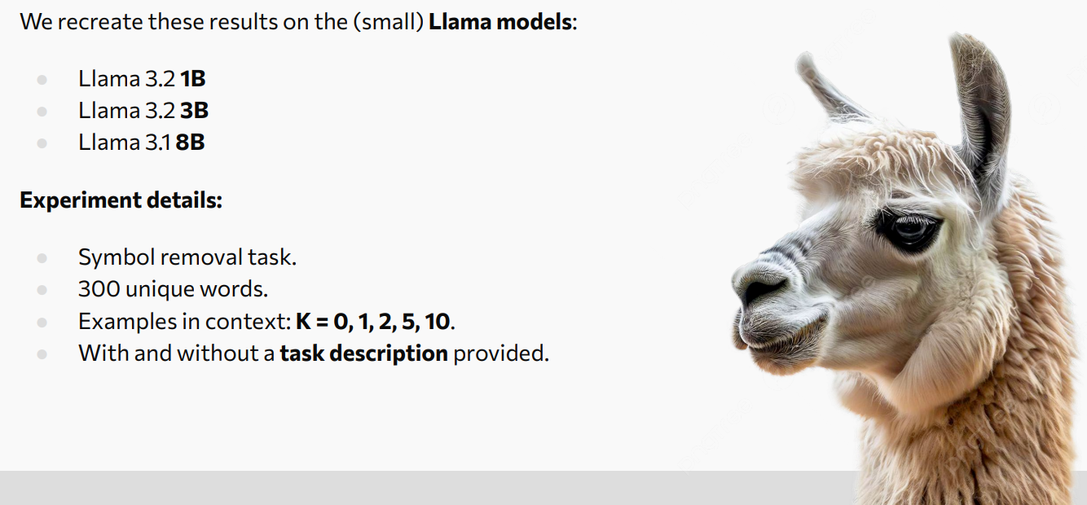
Experiments on the Llama Models

Slide 31
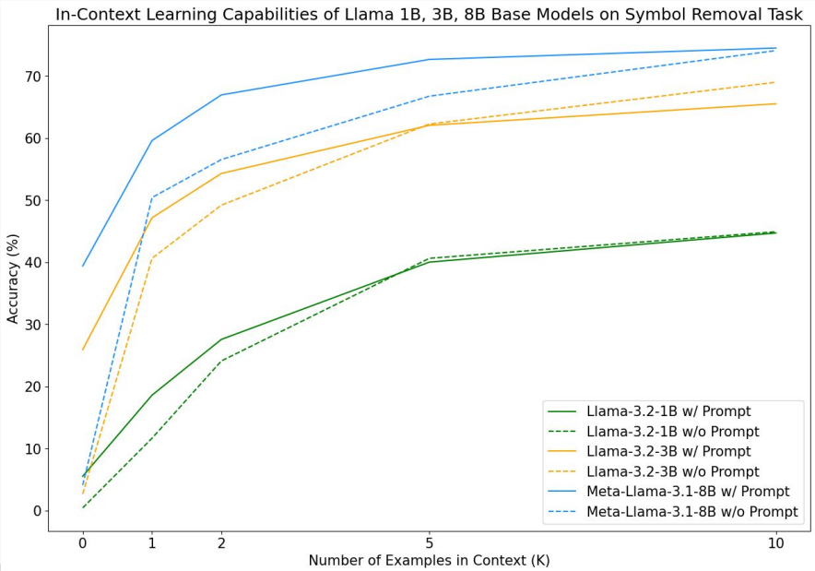
Results on Llama Models
https://github.com/jbxnes/llama-icl
https://github.com/jbxnes/llama-icl

Slide 32
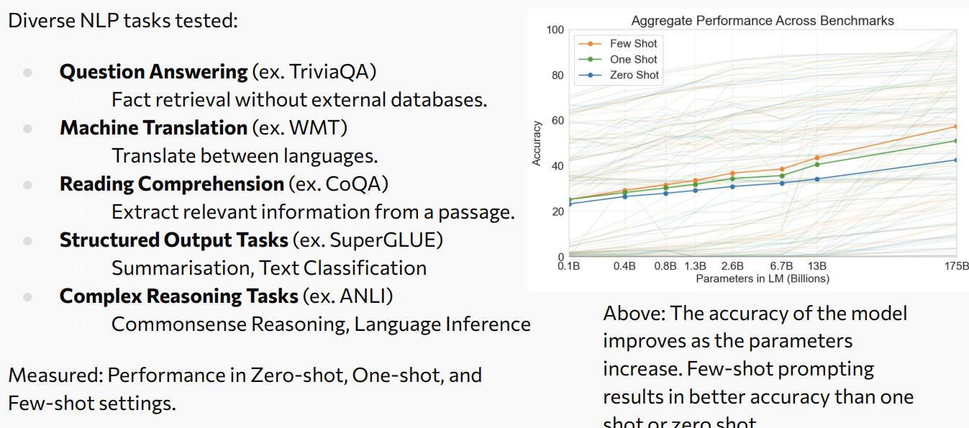
Benchmarks and Tasks

Slide 33
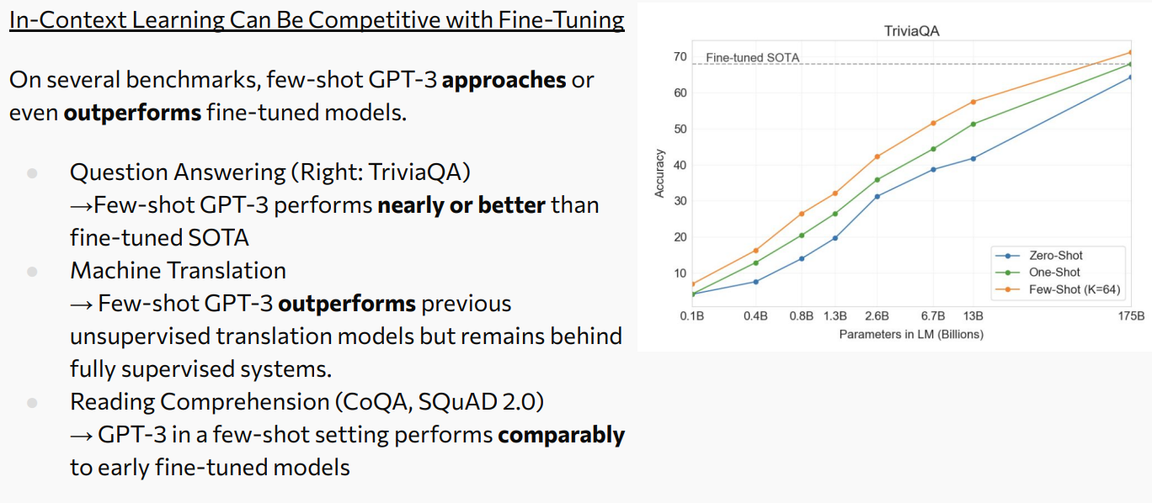
Performance Highlights

Slide 34
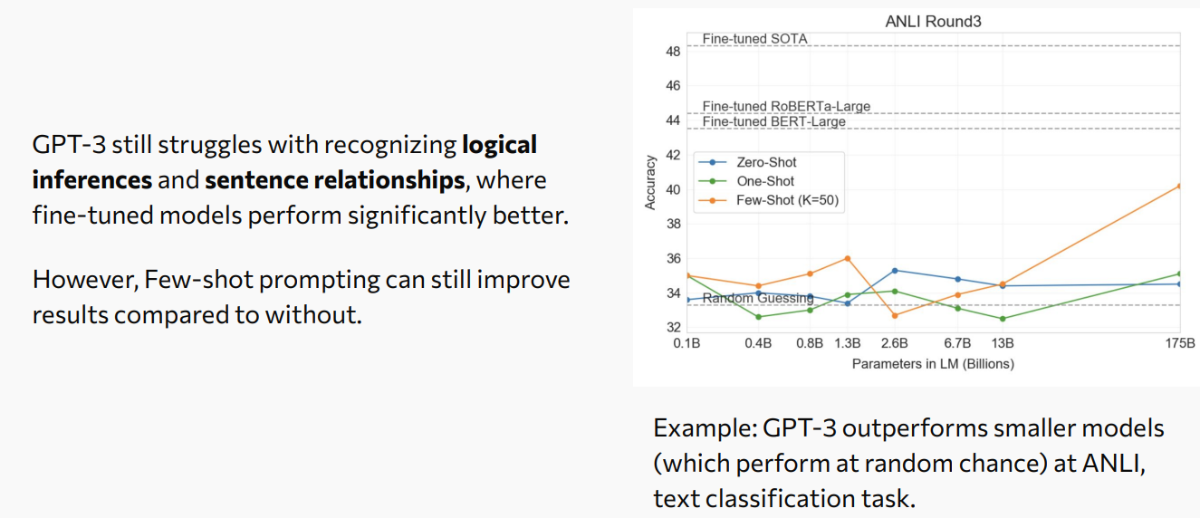
Performance Highlights

Slide 35
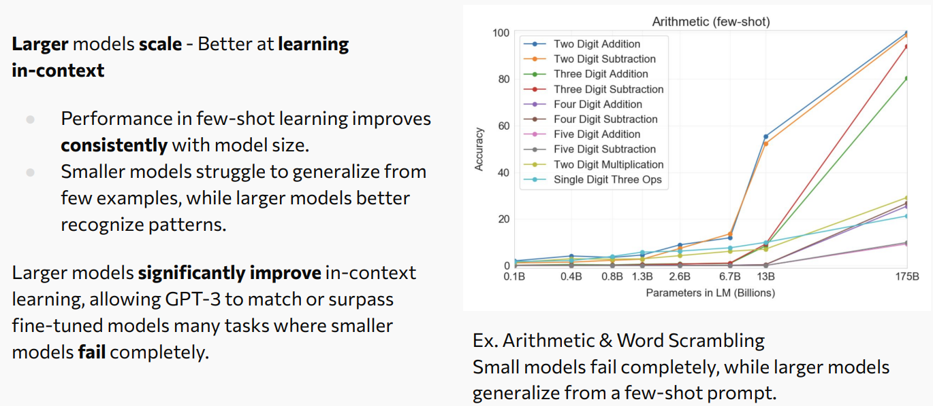
Performance Highlights

Slide 36
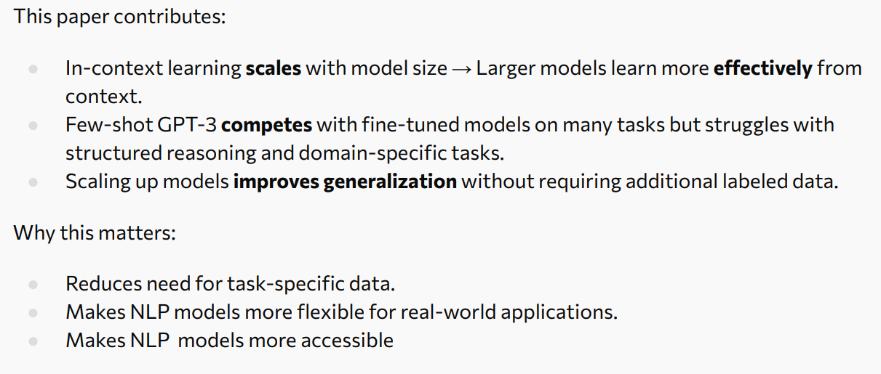
Results and Discussion

Slide 37
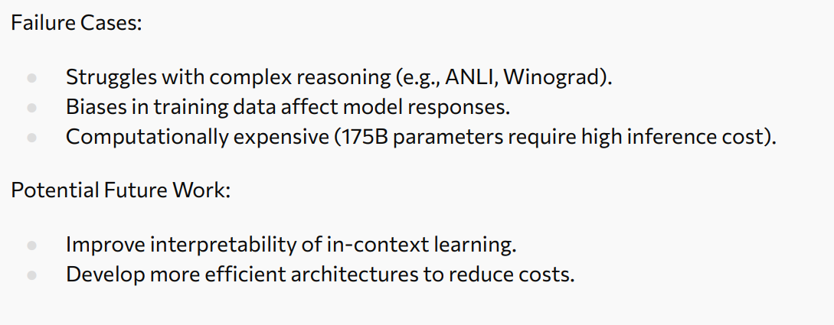
Limitations and Future Work

Slide 38
END OF Language Models are Few-Shot Learners

Slide 39
Comparisons
Aspect | Wei et al. (2022) | Brown et al. (2020)
Models | Multiple sizes, tracking sudden gains | GPT-3 only (175B parameters)
Key Metric | Presence or absence of abilities (emergence) | Few-shot task accuracy/performance
Task Types | Diverse, exploring emergent capabilities | NLP tasks: translation, QA, cloze, arithmetic, etc.
Evaluation Approach | Identify thresholds where abilities appear | Prompt-based, no fine-tuning; compare few-shot levels (0-shot, 1-shot, etc.)
Notes:
The paper Language Models are Few-Shot Learners (Brown et al., 2020) introduces GPT‑3 and demonstrates that extremely large language models can perform diverse tasks using few-shot prompting, without fine-tuning. Its focus is practical: showing predictable improvements in performance as scale increases, enabling flexible adaptation across translation, question answering, and reasoning tasks. In contrast, Emergent Abilities of Large Language Models (Wei et al., 2022) explores a conceptual phenomenon—abilities that appear suddenly at certain model sizes and cannot be extrapolated from smaller models. While both emphasize the transformative power of scale, Brown et al. highlight consistent gains and usability, whereas Wei et al. stress unpredictability and non-linear capability jumps. The former positions large models as versatile tools for real-world applications, while the latter warns that scaling introduces qualitative changes that challenge forecasting and control, raising deeper questions about interpretability and safety.

Slide 40
References
Spreadsheets are all you need. (Feb 20, 2025). FLOPS Demystified: AI and the math behind DeepSeek training costs. YouTube
https://www.youtube.com/watch?v=T3JiBtHHTMU
AssemblyAI. (Jan 3, 2024). The Emergent Abilities of LLMs - why LLMs are so useful. Youtube
https://www.youtube.com/watch?v=bQuVLKn10do
Welch Labs.(Sep 13, 2024). AI can't cross this line and we don't know why . YouTube
https://youtu.be/5eqRuVp65eY?feature=shared
Bal, M. (2025). Emergent abilities of large language models [Lecture slides]. University of Michigan. Retrieved from https://ryanzhumich.github.io/cse587/slides_emergent.pdf
Brown, T. B. (2020). Language models are few-shot learners
https://doi.org/10.48550/arXiv.2005.14165
University of Toronto. (2025). Machine learning: Large model—Language models are few‑shot learners [Lecture slides]. https://www.cs.toronto.edu/~cmaddis/courses/csc2541_w25/presentations/few-shot.pdf

